Slide 1
Employee Attrition Analysis USING EXCEL
student Name : Devishree. K
Register number:31221171
Department :BCOM general A
CollEGe:: thiruthangal nadar college

Slide 2
Project title
Employee Attrition Analysis Using Excel

Slide 3
AGENDA
Problem Statement
Project Overview
End Users
Dataset Description
Modelling Approach
Results and Discussion
Conclusion

Slide 4
PROBLEM STATEMENT
- Title: “Employee Attrition: A Growing Concern” - Description: Briefly explain the issue of employee attrition, its impact on organizations, and the need for analysis.

Slide 5
PROJECT OVERVIEW
Title: “Employee Attrition Analysis Project” Description: Outline the project’s objectives, scope, and timeline.

Slide 6
End users
Title: “Stakeholders and End Users” Description: Identify the stakeholders and end users of the analysis, such as HR, management, and employees.

Slide 7
OUR SOLUTION AND ITS VALUE PROPOSITION
Title: “Predictive Analytics for Employee Attrition Description: Explain how predictive analytics can help identify factors contributing to attrition and inform retention strategies

Slide 8
Dataset Description
Title: “Employee Data Overview” Description: Describe the data used for analysis, including: - Data sources - Variables (demographics, job details, performance metrics, etc.) - Data quality and preprocessing steps

Slide 9
Modelling Approach
Title: “Modelling Employee Attrition” Description: Outline the modelling approach, including: - Logistic regression - Decision trees - Survival analysis - Model evaluation metrics (accuracy, precision, recall, etc.)

Slide 10
RESULTS
Salesperson | May | June | July | August | September | October
Albertson, Kathy | $3,799.00 | $557.00 | $3,863.00 | $1,117.00 | $8,237.00 | $8,690.00
Allenson, Carol | $18,930.00 | $1,042.00 | $9,355.00 | $1,100.00 | $10,185.00 | $18,749.00
Altman, Zoey | $5,725.00 | $3,072.00 | $6,702.00 | $2,116.00 | $13,452.00 | $8,046.00
Bittiman, William | $1,344.00 | $3,755.00 | $4,415.00 | $1,089.00 | $4,404.00 | $20,114.00
Brennan, Michael | $8,296.00 | $3,152.00 | $11,601.00 | $1,122.00 | $3,170.00 | $10,733.00
Carlson, David | $3,945.00 | $4,056.00 | $3,726.00 | $1,135.00 | $8,817.00 | $18,524.00
Collman, Harry | $8,337.00 | $4,906.00 | $9,007.00 | $2,113.00 | $13,090.00 | $13,953.00
Counts, Elizabeth | $3,742.00 | $521.00 | $4,505.00 | $1,024.00 | $3,528.00 | $15,275.00
David, Chloe | $7,605.00 | $3,428.00 | $3,973.00 | $1,716.00 | $4,839.00 | $13,085.00
Davis, William | $5,304.00 | $1,562.00 | $2,945.00 | $1,176.00 | $9,642.00 | $13,714.00
Dumlao, Richard | $9,333.00 | $2,779.00 | $7,549.00 | $1,101.00 | $5,850.00 | $15,065.00
Farmer, Kim | $1,103.00 | $3,470.00 | $3,862.00 | $1,040.00 | $10,024.00 | $18,389.00
Ferguson, Elizabeth | $1,333.00 | $1,913.00 | $4,596.00 | $1,126.00 | $5,503.00 | $10,686.00
Flores, Tia | $12,398.00 | $2,883.00 | $2,142.00 | $2,014.00 | $13,547.00 | $21,983.00
Ford, Victor | $3,251.00 | $4,931.00 | $8,283.00 | $1,054.00 | $9,543.00 | $11,967.00
Hodges, Melissa | $4,624.00 | $4,798.00 | $8,420.00 | $1,389.00 | $10,468.00 | $12,677.00
Jameson, Robinson | $2,552.00 | $4,459.00 | $2,248.00 | $1,058.00 | $6,267.00 | $14,982.00
Kellerman, Frances | $4,281.00 | $4,172.00 | $11,074.00 | $1,282.00 | $2,365.00 | $9,380.00
Table:

Slide 11
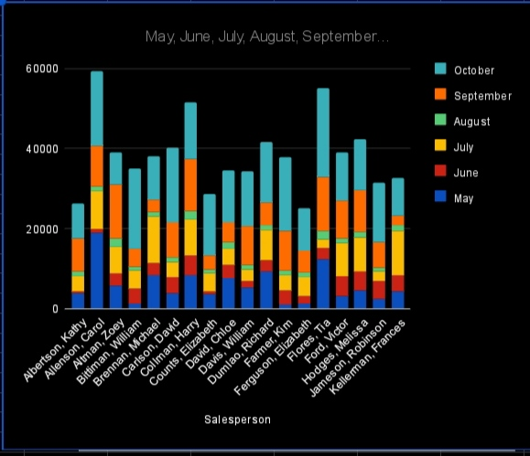
Par chart

Slide 12
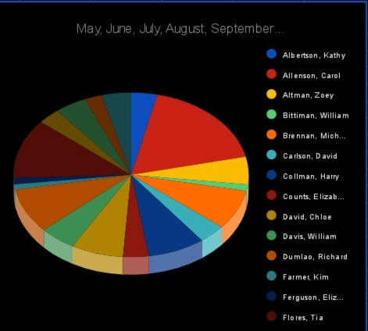
Pie chart:

Slide 13
Conclusion
Title: “Conclusion and Recommendations” Description: Summarize key findings, implications, and recommendations for retention strategies

